Slide 1
A target for refactoring

Slide 2
Software refactoring
One of the problems when developing software is that it often needs to be refactored/reorganized
Design patterns help you determine how to reorganize and they help reduce the amount of refactoring that you need to do later

Slide 3
Object-oriented software phases
Prototyping phase – Lots of activity as the software is created through rapid development until it meets requirements and reaches ‘adolescence’

Slide 4
Object-oriented software phases
Expansionary phase - The software is put into service and may then be required to:
Satisfy more requirements
Be even more reusable
It will go through an expansionary phase to accommodate new requirements
This can’t continue forever though. Software will eventually become more unwieldly

Slide 5
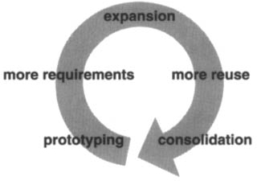
Object-oriented software phases
Consolidation phase – To continue to evolve the software must be reorganized by refactoring
Frameworks often emerge at this stage
Produces many new kinds of objects ,often by object decomposition
Object composition replaces inheritance
The continual need to satisfy more requirements and reuse means repeated cycles of expansion and consolidation occur

Slide 6
Design Patterns
Software expansion/ consolidation cycle unavoidable
Good design of class and object structure can help avoid restructuring.
Creates robust code in the face of change
Design patterns capture many of the structures that result from restructuring
Using design patterns early can prevent refactoring later.
Patterns are still able to help change a system even if they aren’t used initially

